Slide 1
Devolution and Local Government Reorganisation
Lorna Ford (Chief Executive, Rother District Council)

Slide 2
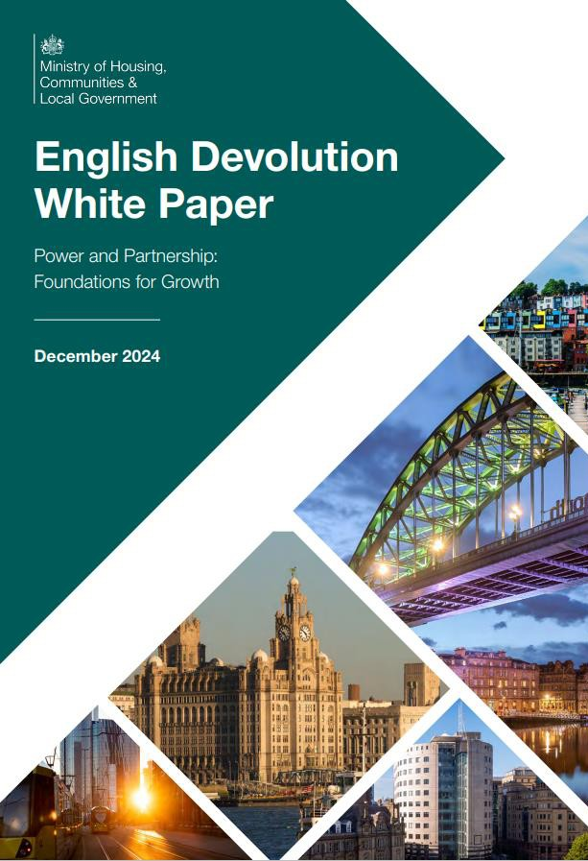
Devolution White Paper
English Devolution White Paper published 16 December – outlines plans for devolution and LGR:
Devolution – Establishing regional strategic authorities, each with an elected Mayor. These will cover populations of at least 1.5 million.
LGR – Replacing two-tier local government with unitary authorities. These will cover populations of at least 500,000.
Devolution and LGR to progress together in areas under the fast-track Devolution Priority Programme
Notes:
English Devolution White Paper included a new devolution framework with an ambition to see mayoral devolution delivered across England, an enhanced set of powers, and a requirement for all remaining two-tier local authorities (including small unitary authorities) to put forward proposals for local government reorganisation.
Government wants universal coverage of ‘Strategic Authorities’ - Mayors and councils working together, covering areas that people recognise and work in.
All Strategic Authorities will be either:
Established Mayoral Strategic Authorities, for those existing MCAs who meet specified eligibility criteria. This unlocks further devolution.
Mayoral Strategic Authorities, such as all MCAs and mayoral CCAs.
Foundation Strategic Authorities, such as non-mayoral CAs and CCAs. In ‘exceptional circumstances’ a single Authority could be designated an FSA.
Areas that want Mayors will be prioritised for devolution and an ambition for all areas to move to a mayoral model
Powers and funding available to each type of authority – focus on driving growth, including Transport, Skills and Employment Support, Housing and Planning, Environment and Climate Change, Supporting Businesses and Research, Reforming and Joining Up Public Services.
All areas, with or without a Strategic Authority, will be expected to produce a Spatial Development Strategy as part of Government’s commitment to move towards a universal system of strategic planning within the next five years
Government will facilitate a programme of local government reorganisation for two-tier areas, and for unitary councils where there is evidence of failure or where their size or boundaries may be hindering their ability to deliver.
Reorganisation should not delay devolution and plans for both should be complementary.

Slide 3
Current Tiers of Government in Sussex
National Government
Delivery and coordination of national level services, including defence, macroeconomic policy, and health.
County Authority (East Sussex County Council- ESCC)
Delivery of services including education, social services, road and transport, waste disposal, economic development, countywide planning and the environment, protecting the public, and libraries.
District and Borough Councils (including RDC)
Delivery of services including waste collection, tourism, environmental health, leisure, planning permission, housing needs services, collection of council tax.
Town & Parish Councils
Delivery of services including parish lighting, grants for local projects and organisations, recreation and sports fields.

Slide 4
Proposed Tiers of Government in Sussex
National Government
Delivery and coordination of national level services, including defence, macroeconomic policy, and health
Mayoral and Enhanced Strategic Authorities are represented through the Council of Nations and Regions and the Mayoral Council
Strategic Authorities (Mayoral County Combined Authority)
Principal Authorities come together to form Strategic Authorities. Strategic Authorities coordinate levers relating to local growth and issues crossing council boundaries, such as infrastructure planning, transport, and spatial planning, while convening partners for public service reform
Devolution
District and Borough Councils
Mayors may also come together across larger geographical areas to collaborate on inter-regional issues, like energy and water
Principal Authorities (Unitary Authority)
Delivery of local public services, place shaping and local public service reform.
LGR
ESCC
Town & Parish Councils
Delivery of local-level services.
Local authorities are represented through the Leaders Council

Slide 5
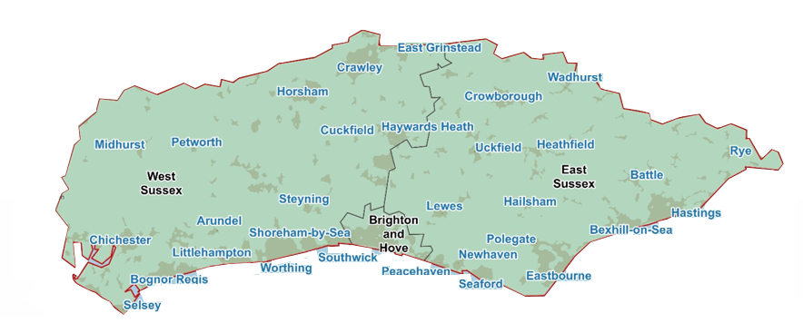
Proposals for the Mayoral Authority
Sussex has been accepted onto the Devolution Priority Programme - for areas who wish to pursue establishment of a Mayoral Strategic Authority at pace. This will be with a view to holding inaugural mayoral elections in May 2026.
Geography to cover Sussex and Brighton- approx. 1.7m
Receive devolved funding from central government, including for housing, regeneration, local growth, transport
Mayor and 2 representatives from each council (upper tier/unitary)
Constituent members will be decision-makers

Slide 6
Funding of Mayoral Authorities
Government has committed to a simplified funding landscape- MCCA/MCAs will receive:
a consolidated
funding pot for:
- local growth;
- housing/ regeneration;
- adult skills;
- local transport
the ability to
impose a “Mayoral Community
Levy”, to help deliver local infrastructure
a 30-year Investment Fund to drive economic growth
the ability to raise a precept to generate money for local priorities
The Devolution Priority Programme involves:
Starting the clock on getting to Established status – unlocking the single settlement
Backing from Government, including Ministerial support and engagement and capacity funding

Slide 7






Government Consultation on Mayoral Authority
The government recently held a consultation on views for the proposed Mayoral Combined County Authority for the local government areas of East Sussex, West Sussex, and Brighton.
The outcome will inform Ministerial decision on whether to proceed – expected Spring 25
Following engagement with our stakeholders, RDC’s response highlighted:
Need for a broader review of local government funding
Importance of local identities and knowledge, particularly in rural areas
Support for town and parish councils in delivering effective public services
Importance of balancing representation, including in proposed names for the new authority
Opportunities for investments, funding, and better coordination of strategies and infrastructure projects
Potential to create efficiencies

Slide 8
Timeline for Devolution and LGR
DEVO
13th: Government consultation closes- Rother to submit a corporate response
Results of the consultation, then a Ministerial decision on whether to proceed
Elections for Mayor
March 25
April 25
Spring 25
May 25
Sept 25
End of 25/Early 26
May 26
April 27
April 28
LGR
19th: Extraordinary Council - Interim Plan
Final proposals submitted- Cabinet to sign off
Shadow unitary in place
Development of business case – to include stakeholder engagement
Ministers consider proposals for new unitaries
21st: Interim Plan submitted
Unitary authority go-live

Slide 9
Development of the Interim Plan for LGR
At Full Council on 19 March, the Interim Plan for LGR was approved. It was submitted to the Minister on 21 March.
The Plan outlines a proposal for a single unitary authority on the East Sussex boundary. It was jointly submitted by all councils in East Sussex and sets out:
  Barriers and challenges.
  Options for size and boundaries.
  Indicative costs – including planning for future service transformation opportunities, the cost of preparing proposals, implementation team.
  Councillor numbers – effective democratic representation balances needs of towns, rural and coastal areas (in line with LGBCE guidance).
  How structures support devolution.
  A summary of local engagement, views expressed and further local engagement plans.
  Voluntary arrangements to keep all councils involved in discussions.

Slide 10
Key Principles
Improves outcomes for residents and communities
Maximises and makes best use of resources now and for the future
Is Member led and developed in collaboration with a range of stakeholders, including public sector partners, business and VCSE
Supports the staff in all councils as they are crucial to delivery during transition and beyond
Enhances local democracy, local identity, transparency, accessibility, local decision making and accountability (including through scrutiny)
Supports and drives decision making and public service reform at both Sussex and local level
Provides a stronger and unified voice to help attract investment and tackle priorities

Slide 11
Protecting Local Services: Asset and Devolution Framework
Provide clarity of process and decision-making to support partnership outcomes
Protect and sustain assets and services for local communities
Reduce subsidies and minimise future liabilities
OBJECTIVES
Some exemptions from framework- income generating assets, assets held for future capital realisation, assets held for future development, land or buildings that may generate a capital receipt
Statutory functions cannot be easily devolved; therefore, services/assets are likely to be discretionary services
Parish and Town Councils (P&TCs), plus other selected partners prioritised. Eligibility criteria apply.
SCOPE

Slide 12
Protecting Local Services: Asset and Devolution Framework
PROCESS
Available asset and service information will be shared – inc. TUPE
Property & Service Investment & Disposal Panel (PSIDP) consider EOIs
A Business Plan may be requested by the PSIDP
Expressions of Interest period – deadline 30 September: first come, first served
RDC assess viability and internal consultation
PSIDP recommend transfer to Council (Heads of Terms)
Transfer

Slide 13
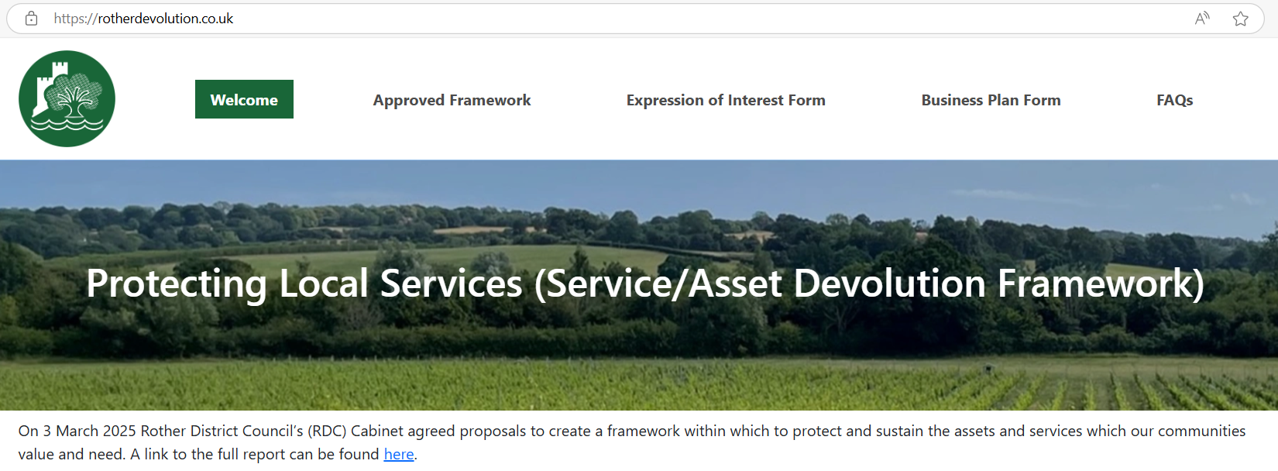
Protecting Local Services: Asset and Devolution Framework
Next steps
Rother devolution website has been set up with information on FAQs and the Expression of Interest Form: Asset Devolution
Questions can be sent to a dedicated inbox: Devolution@rother.gov.uk

Slide 14
Feedback, questions & answers

